Slide 1

Lecture
on
“Advanced Computer Architecture –TCS 704”
by
Akansha Gupta
DEPARTMENT OF COMPUTER SCIENCE AND ENGINEERING
GRAPHIC ERA DEEMED TO BE UNIVERSITY – 248002

Slide 2
Techniques for Fast Address Translation

Slide 3
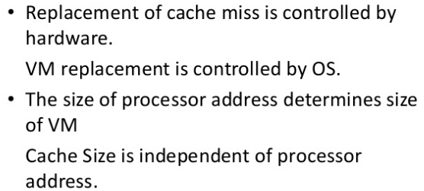
Difference between Cache and VM

Slide 4
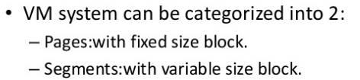
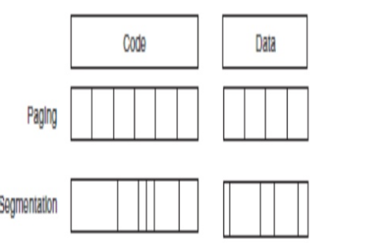

Slide 5
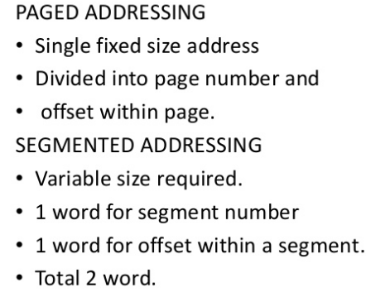

Slide 6
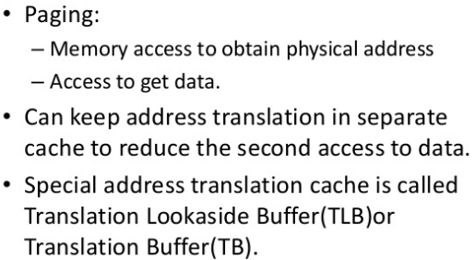
Techniques for Fast Address Translation

Slide 7
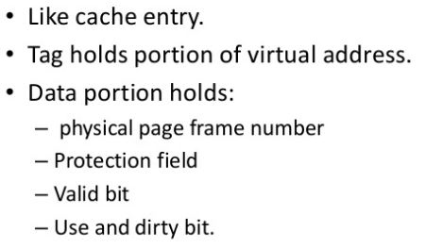
TLB

Slide 8
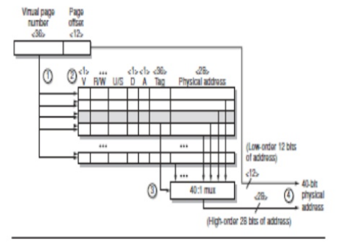

Slide 9
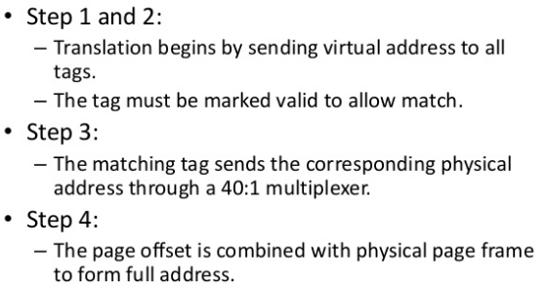

Slide 10
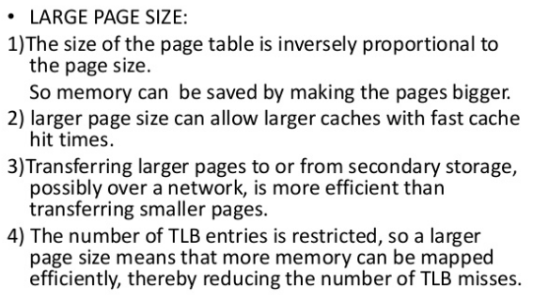
Selecting a Page Size

Slide 11
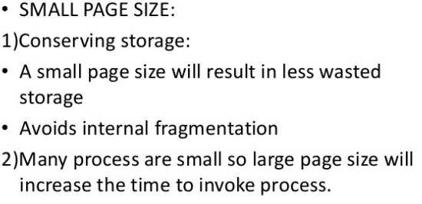

Slide 12
https://youtu.be/T3o1KLJphHY
Thanks

